Slide 1

Police Shootings in the United States
Kevin Angotti - Hedyeh Erfani - Jennifer Ruiz

Slide 2
The problem
Issue
Context
Problem statement
Police shootings have become a hot button topic in the media over the last decade. Deaths of minority assailants have increased sharply over the last decade.
Fatal Police Shooting data is catalogued by the FBI and available to the public.
This data will be used to examine effects of race on police shootings.
The project team will explore factors such as race of assailant, gender, mental illness, and race of officer involved to better understand and predict fatal police shootings.

Slide 3
Challenges deep-dive
Challenge 1
Challenge 2
Challenge 3
Model Effectiveness
How the model handled the data was not as expected and the need to expand on the linear model to run on different measures to provide any sort of positive outcome.
Determining the Target
Race seemed to be the best target variable
Armed type and Body Camera were also contenders
Prediction
Will combinations of K-Modes, Linear Regression and Decision Trees provide a good enough prediction power to be useful in training tools.

Slide 4
Solution
The project team will use a suite of predictive models to identify and predict which factors lead to police shootings.
Use Predictive Analytics to gain insight and identify patterns

Slide 5
Implementation
Notes:
First we will look at some insights the data is telling us about race, if the victim was armed, as well as the locations shooting happened.

Slide 6
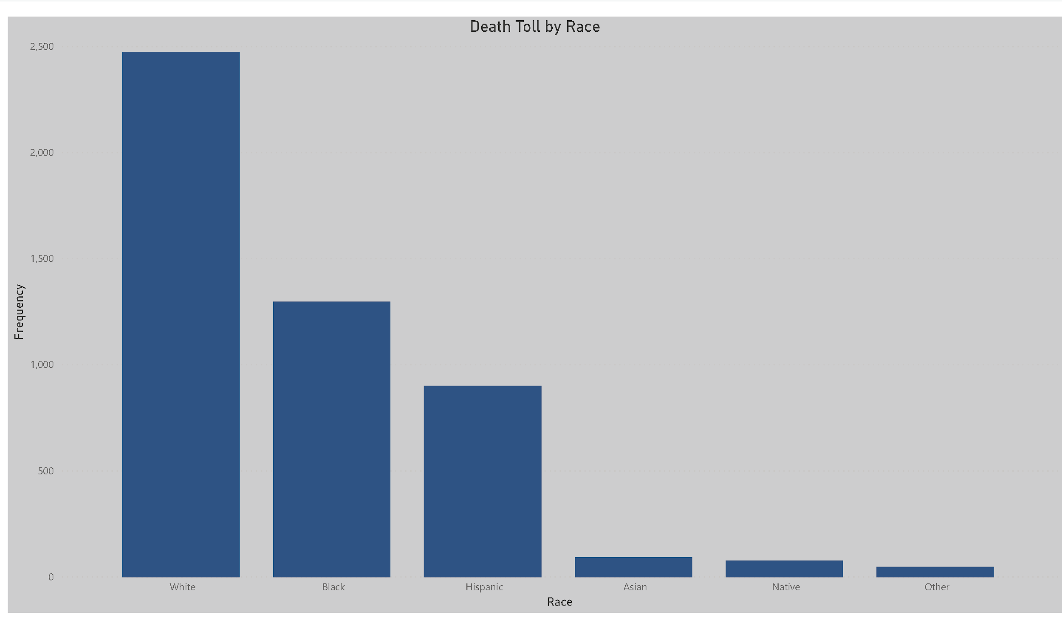
Death by Race
Notes:
Sinse 2015 White, Black, and Hispanic individuals were most often killed in police shootings.

Slide 7
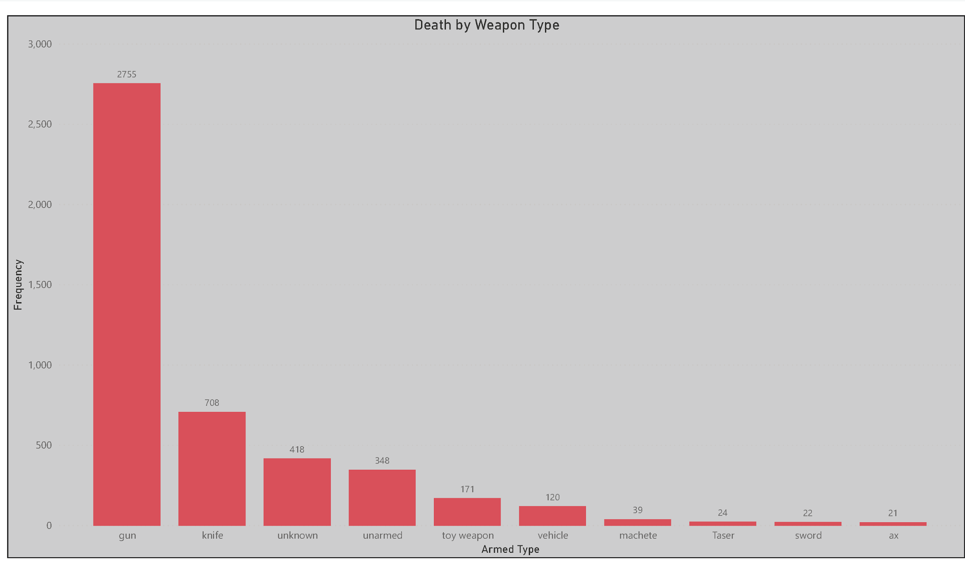
Top 10 Weapons Used
Notes:
Most common weapon possessed by shooting victims were guns, knives, unknown weapons, or being unarmed.

Slide 8
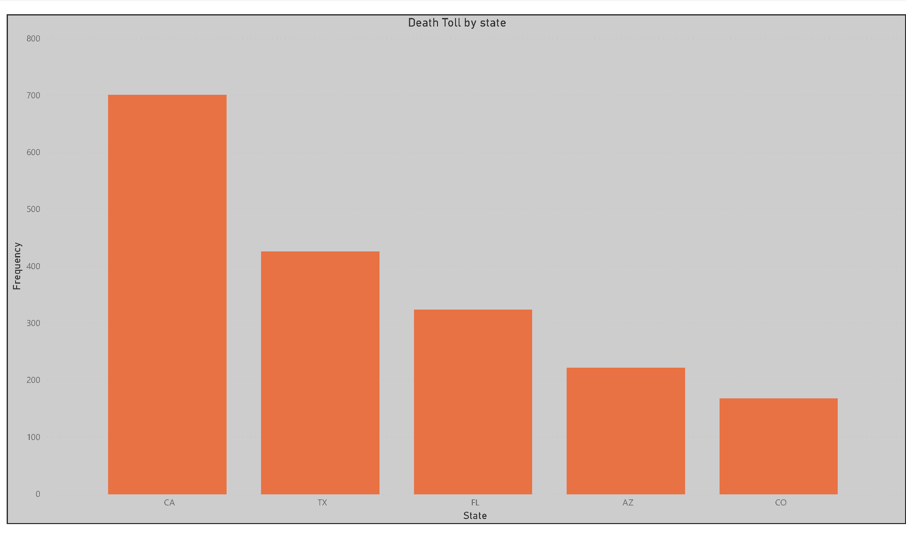
Top 5 State’s by Police Shootings
Notes:
California, Texas, and Florida lead the country with the highest number of deaths by Police Shooting.

Slide 9
Approaches to Modeling
The project team chose a variety of methods to examine this issue. Each provided its own insight which helped to build the bigger picture.
Notes:
Models such as K-Modes (categorical) and Linear Regression were thought to provide the best prediction on the dataset. Accompanied with a Decision Tree that would predict on plausible outcomes.

Slide 10
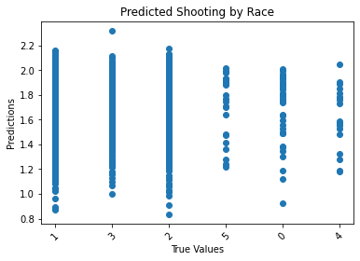
Linear Regression
Prediction model 1
Notes:
Model returns accuracy between 0.05 and 0.11, determined to not be a good predictor likely due to not having enough data. The model only had 6 features and to go with the target variable.

Slide 11
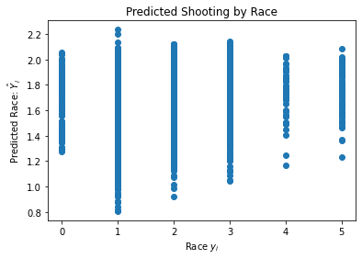
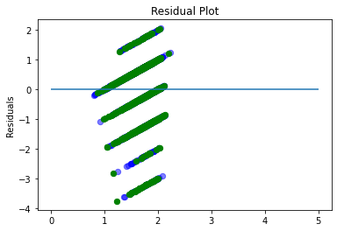
Linear Regression
Prediction Model 2
Notes:
Model 2 returned Means Squared Error (MSE) of 0.81 to 0.86 for the dataset, most of the residuals fall within the +1 -1 threshold. Similar to the first linear model, provided a good value for the MSE and is able to show where the error is occuring. (Black and White shooting victims). Model was run two different ways with all 6 features and with only 1 feature (armed) thought to be a good predictor.

Slide 12
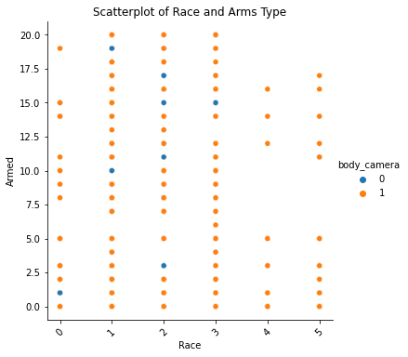
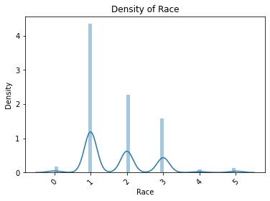
Examining Body Camera Involvement
Density of Race and Scatter of Body Camera Present
Notes:
As shown by Top Left visual, body cameras were rarely present or in use when shootings occurred. Bottom right visual shows that highest density of races were White, Black, and Hispanic. Body cameras not present in just about most of the shootings should be a key tae a way here for any potential change. Had there been more cameras the footage could be used a training tools.

Slide 13
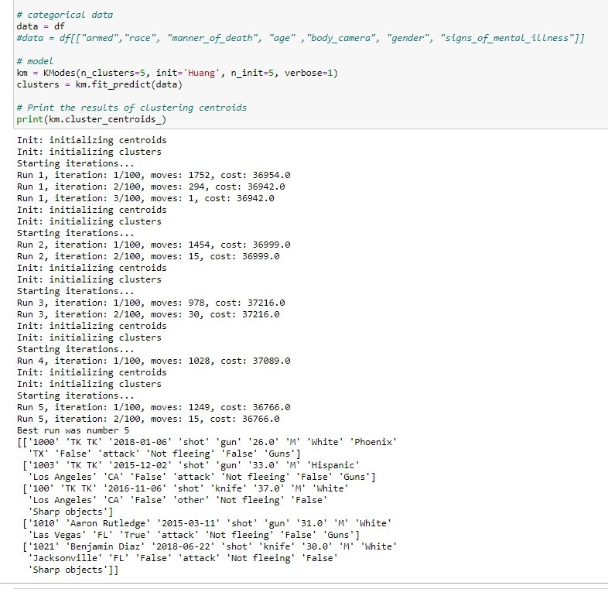
K-Modes Clustering Model
Most common method of death: shot
Subjects were not fleeing
Subjects were White Males
Armed with Weapon varied
Body Cameras were not in use
Indication of Mental Illness was a factor
Top 3 states:
California
Texas
Florida

Slide 14
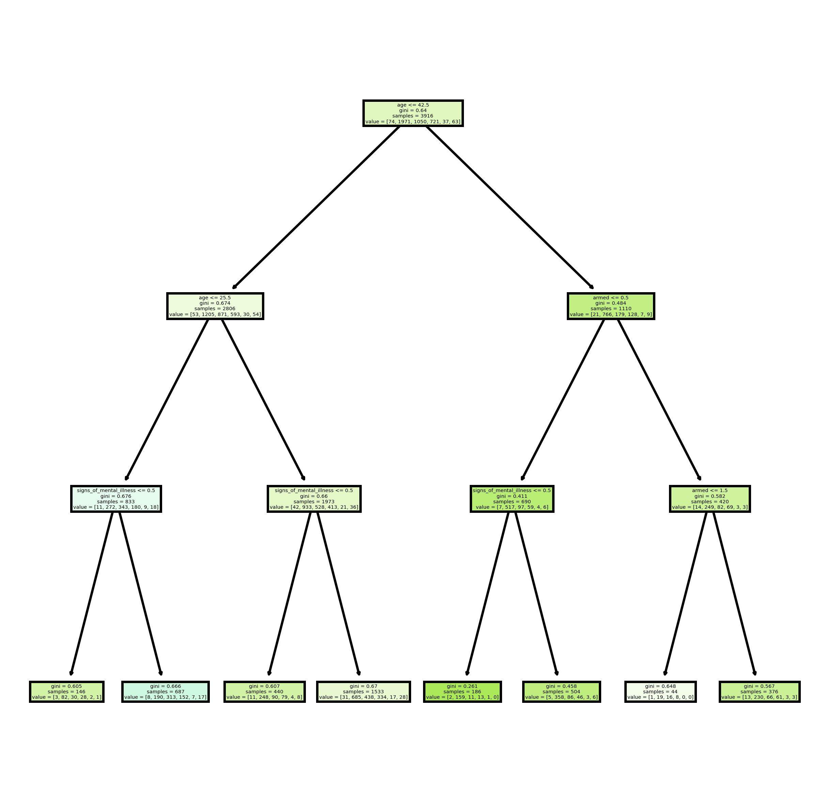
Decision Tree
1
2
Prediction Model 3
3
4
Notes:
A person under the age of 42 (1, top node) and also under the age of 25 (2, second node left) with signs of mental illness (3, third node left) will predict that shooting victims will be as follows (4, terminal node/leaf), 3 Asian, 82 White, 30 Black, 28 Hispanic, 2 Other, and 1 Naive.

Slide 15
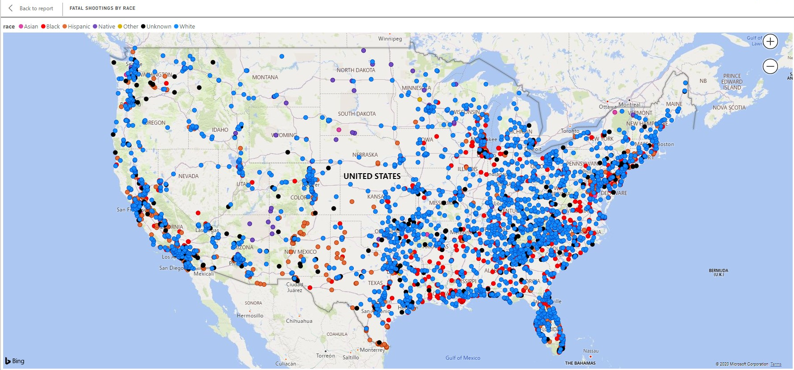
Police Shootings in lower 48
The nationwide trend shows white males as being killed most often. However, in metropolitan areas, black men are killed more often.
Notes:
Blue - race = White
Red - race = Black
Orange - race = Hispanic

Slide 16
Conclusion
This project uncovered useful insights that can be applied to future prediction models.
Further research, education, and training is needed to combat this issue.
Understanding Police Shootings is a complex issue involving many factors.
Notes:
We believe more data is a necessity here. Expanding on the current variables and adding in more features. For better prediction a model needs more than just age, sex, race, armed type, and body cameras. We believe time of day, weather, drug possession, and even monetary factors could be useful here.

